Slide 1
CMP203 Graphics Programming
Lighting Part 1

Slide 2
This week
More than a triangle aka cube
Lighting
Real World Lighting
Lighting in Real-time 3D graphics
Light sources
Types of light
Implementing lights in OpenGL

Slide 3
More than triangles
Creating a simple 3D object
a cube
Many options, but we will focus on the main two options
Build 6 faces positioned to create a cube
Using GL_QUAD
Makes building it quite easy
Using GL_TRIANGLES
More complex to build, but quads aren’t always supported
You need to learn to think in triangles
So you should try to build the cube with triangles

Slide 4
CUBE!
glBegin(GL_QUADS);
// front face
glColor3f(1.0f, 0.0f, 0.0f);
glVertex3f(-0.5f, 0.5f, 0.5f);
glVertex3f(0.5f, 0.5f, 0.5f);
glVertex3f(0.5f, -0.5f, 0.5f);
glVertex3f(-0.5f, -0.5f, 0.5f);
// right face
glColor3f(0.0f, 1.0f, 0.0f);
glVertex3f(0.5f, 0.5f, 0.5f);
glVertex3f(0.5f, 0.5f, -0.5f);
glVertex3f(0.5f, -0.5f, -0.5f);
glVertex3f(0.5f, -0.5f, 0.5f);
// bottom face
glColor3f(0.0f, 0.0f, 1.0f);
glVertex3f(0.5f, -0.5f, 0.5f);
glVertex3f(0.5f, -0.5f, -0.5f);
glVertex3f(-0.5f, -0.5f, -0.5f);
glVertex3f(-0.5f, -0.5f, 0.5f);
glEnd();

Slide 5
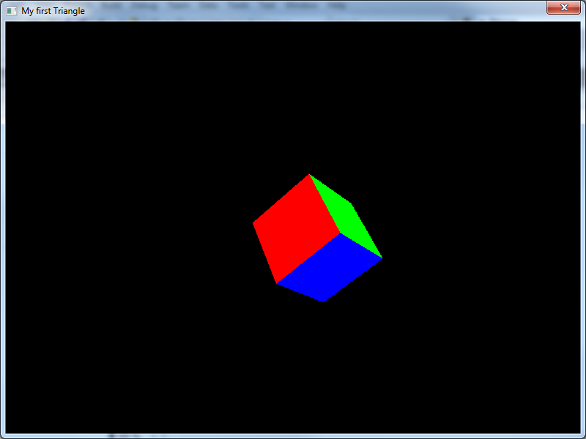

Slide 6
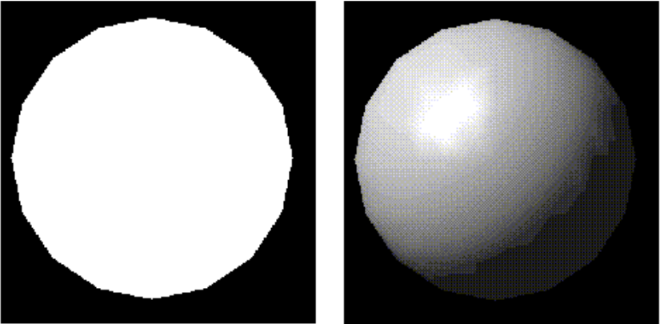
Lighting
Unlit vs Lit

Slide 7
Lighting in the Real World
We perceive objects by interpreting the light that bounces off them
Interaction of light and the surface of the object helps us build up an idea of the position and the material of the object
The Physics
Light is Electromagnetic Radiation
Light travels in straight lines unless it hits an object or passes though another medium
(or its bent by a gravitational lens but that isn't really something we need to worry about)
Photons Exhibit the characteristics of both a wave and a particle (Look at Young’s interference experiment if you want to break your brain.)

Slide 8
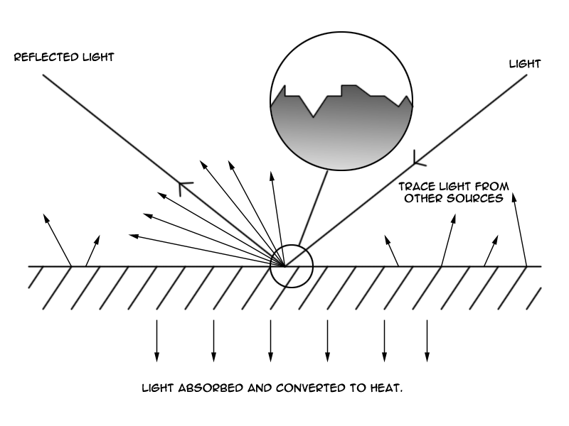
Lighting in the Real World
Light interaction with a surface (Single source)

Slide 9
Lighting in the Real World
Example lighting situation: Game lab
Primary Light sources
The Sun
Roof Lights (multiple)
Monitors(30-ish)
Secondary sources
Countless light interactions between light sources contributing to Ambient Light
Accurate simulation of this simple situation is incredibly complex
It can be done, but challenging to do in real-time

Slide 10
Lighting in Real-time 3D Graphics
How can we hope to achieve any kind of believable lighting in a Real-time game?
Use approximations
Emulate some of the main characteristics of light in a basic way
Human Brain fills in the gaps

Slide 11
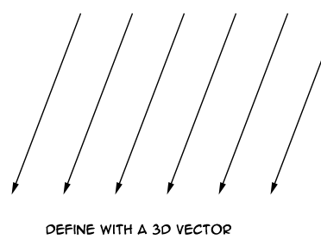
Lighting in Real-time 3D Graphics
First step - Defining light sources
There are three sources of light commonly used in computer graphics that cover most situations
Directional Light

Slide 12
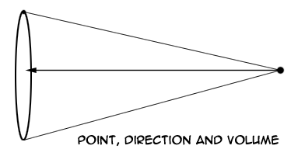
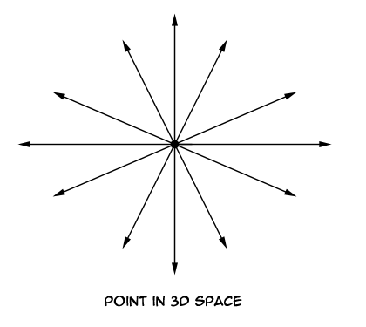
Lighting in Real-time 3D Graphics
Point Light
Spot Light

Slide 13
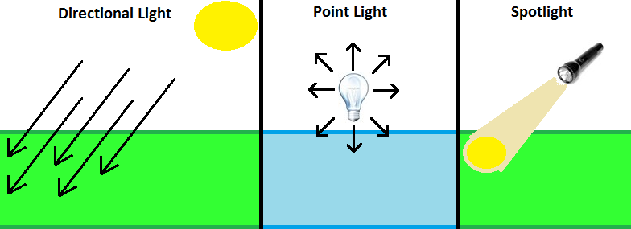
Another example

Slide 14
Lighting in Real-time 3D Graphics
We need to be able to set the attributes of these lights
Colour
Intensity
Brightness of the light
Falloff
Governs the Light intensity over distance, useful for simulating different mediums

Slide 15
Lighting in Real-time 3D Graphics
Where we calculate Lighting in the graphics pipeline:
Modelling/Viewing -> Lighting -> Projection
Lights are placed in the scene like objects
As soon as we have built our world and placed lights, we can calculate lighting
Best practice is to place lights first
When Lighting calculation is finished, each Triangle in the scene will have a colour value associated with it
Rasteriser blends these values into the finished surface

Slide 16
The Lighting Calculation
There are three major components that effect lighting
Ambient
Comes from everywhere
Diffuse
From a particular direction, brighter if square onto surface
Specular
Bounces off shape at a particular angle (Shiny), laser bouncing off mirror
Shiny metal & plastic have a high specular value
Chalk and carpet have little to none
Next week
These three components give a suitable lighting effect
These components are determined by the properties of the light and the material

Slide 17
Lighting in Real-time 3D Graphics
Ambient
Light that has been scattered so much by the environment that it’s direction and source are impossible to determine
It seems to come from all directions
This is a ‘minimum’ light value that the object will receive whether it is near the light or not
This is used to approximate the extremely scattered light that bounces around a scene

Slide 18
Lighting in Real-time 3D Graphics
Diffuse
Light that comes from a single direction
Is brighter when it comes squarely down on a surface
Compared to when it glances off a surface
Any light coming from a particular position or direction will have a diffuse component

Slide 19
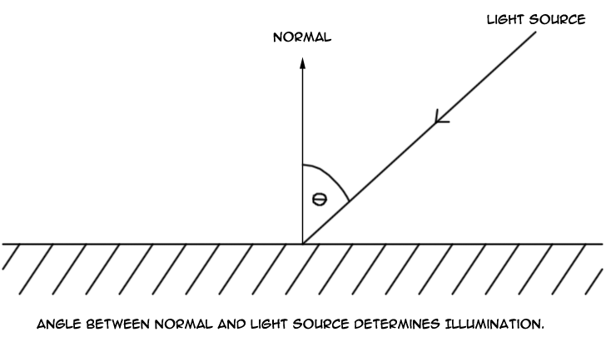
Lighting in Real-time 3D Graphics
Diffuse Component
Calculated using Light, and surface normal

Slide 20
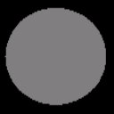
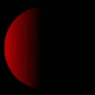
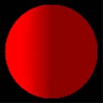
Pictures
Ambient lit
Diffuse lit
Ambient + diffuse
Diffuse values are added to the ambient values

Slide 21
Normals
Before we calculate light, we must have information regarding the surface the light is interacting with
We use normal Vectors (A vector of unit length) to describe the direction perpendicular to the surface
For a flat surface the normals will point in the same direction
But for more complex shapes each normal can be a different directions

Slide 22
Normals
We can specify normals in two ways
One for each polygon
Poor lighting
One for each vertex
Good lighting
Ultimately in high end graphics a normal per-fragment is used
Normals are used during lighting calculations to determine light intensity
Specify normals using the function
glNormal3f(nx, ny, nz);
Must be done before the glVertex3f() call

Slide 23
OpenGL Implementation
glBegin (GL_TRIANGLES); //Begin drawing state
glNormal3f( 0.0f, 0.0f, 1.0f);
glVertex3f( 0.0f, 1.0f, 0.0f);
glNormal3f( 0.0f, 0.0f, 1.0f);
glVertex3f(-1.0f, 0.0f, 0.0f);
glNormal3f( 0.0f, 0.0f, 1.0f);
glVertex3f( 1.0f, 0.0f, 0.0f);
glEnd(); //end drawing

Slide 24
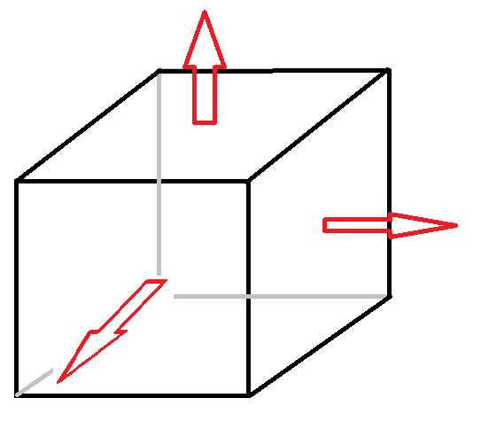
Normals Per Face

Slide 25
Normals Per Face Code
glRotatef(_angle, 0.0f, 1.0f, 0.0f);
glBegin(GL_QUADS);
//Front
glNormal3f(0.0f, 0.0f, 1.0f);
glVertex3f(-1.0f, -1.0f, 1.0f);
glVertex3f(1.0f, -1.0f, 1.0f);
glVertex3f(1.0f, 1.0f, 1.0f);
glVertex3f(-1.0f, 1.0f, 1.0f);
//Right
glNormal3f(1.0f, 0.0f, 0.0f);
glVertex3f(1.0f, -1.0f, -1.0f);
glVertex3f(1.0f, 1.0f, -1.0f);
glVertex3f(1.0f, 1.0f, 1.0f);
glVertex3f(1.0f, -1.0f, 1.0f);
......

Slide 26
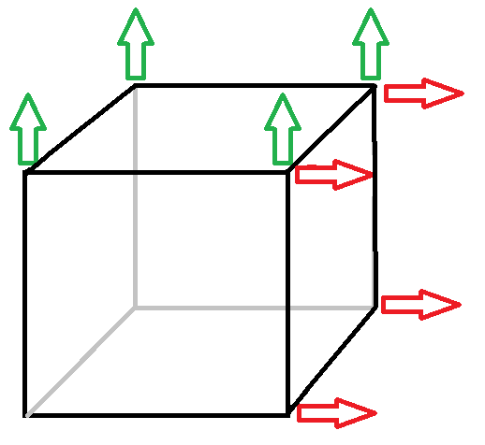
Normals Per Vertex

Slide 27
Normals Per Vertex Code
glRotatef(angle, 0.0f, 1.0f, 0.0f);
glBegin(GL_QUADS);
//Front
glNormal3f(0.0f, 0.0f, 1.0f);
glVertex3f(-1.0f, -1.0f, 1.0f);
glNormal3f(0.0f, 0.0f, 1.0f);
glVertex3f(1.0f, -1.0f, 1.0f);
glNormal3f(0.0f, 0.0f, 1.0f);
glVertex3f(1.0f, 1.0f, 1.0f);
glNormal3f(0.0f, 0.0f, 1.0f);
glVertex3f(-1.0f, 1.0f, 1.0f);
...

Slide 28
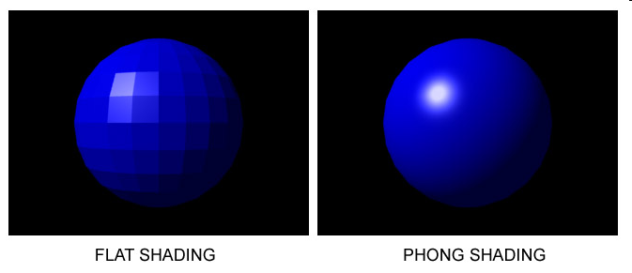
Flat Shading
Single Colour value on each surface
Very Fast
Poor results visually

Slide 29
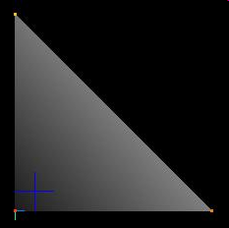
Gouraud Shading
Widely used
Requires Vertex colour from lighting calculation
Performs a linear interpolation between the vertex colours across the surface

Slide 30
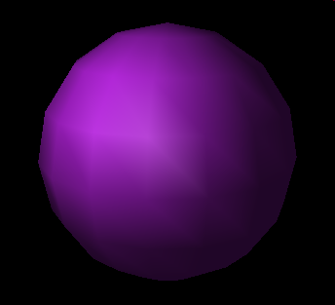
Gouraud Shading
Very fast to calculate (On modern computers its almost trivial)
Much better results
Specular highlights can
Be lost because of the blending
Can be fixed by increasing the amount of polygons

Slide 31
Phong Shading
Lighting is calculated per-pixel
Phong shading creates a vector, for every pixel by interpolating between vertex normals to obtain a new shading normal
Smooth accurate shading for the model
Specular highlights rendered correctly (even in the middle of a triangle)
Commonly used in shaders for simple “per-pixel” lighting

Slide 32
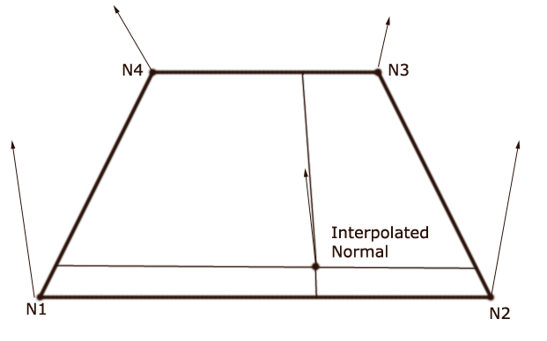
Phong Shading

Slide 33
Phong Shading

Slide 34
OpenGL Shading Modes
Flat and Gouraud shading are available in OpenGL
Gouraud is enabled by default, but if you wish to change shading modes:
glShadeModel(GL_SMOOTH);
glShadeModel(GL_FLAT);

Slide 35
OpenGL Implementation
Defining Lights in OpenGL
GLfloat Light_Ambient[] = {0.3f, 0.3f, 0.3f, 1.0f};
GLfloat Light_Diffuse[] = {1.0f, 1.0f, 1.0f, 1.0f};
GLfloat Light_Position[]= {3.0f, 0.0f, 3.0f, 1.0f};
We can have separate colours for Diffuse and Ambient components of the light
glEnable(GL_LIGHTING);
In the Scene constructor we need to enable lighting

Slide 36
OpenGL Implementation
Add the light to the scene
gluLookAt(0, 0, 6, 0, 0, 0, 0, 1, 0);
glLightfv(GL_LIGHT0, GL_AMBIENT, Light_Ambient);
glLightfv(GL_LIGHT0, GL_DIFFUSE, Light_Diffuse);
glLightfv(GL_LIGHT0, GL_POSITION, Light_Position);
glEnable(GL_LIGHT0);

Slide 37
Direction light example
To define a Direction light we need a minimum of two components
Diffuse colour/light
Direction
In this example we will set the diffuse colour to be a very bright white
GLfloat Light_Diffuse[] = {1.0f, 1.0f, 1.0f, 1.0f};

Slide 38
Directional light example
The position variable contains 4 values
x, y, z, w
The W component will describe how the position values are to be used
A ‘w’ value of 0.0 indicates a directional light
Using the x, y and z we can describe the infinite position of the light and the direction the light travels
X: 1 = light travels negatively along the x-axis -1 = light travels positively along the x-axis
Y: 1 = light travels negatively down the y-axis
-1 = light travels positively up the y-axis
Z: 1 = away from you
-1 = towards you

Slide 39
Directional example
Here we will setup the light to be white and travel positively along the x-axis
GLfloat Light_Diffuse[] = {1.0f, 1.0f, 1.0f, 1.0f};
GLfloat Light_Position[]= {-1.0f, 0.0f, 0.0f, 0.0f};
glLightfv(GL_LIGHT0, GL_DIFFUSE, Light_Diffuse);
glLightfv(GL_LIGHT0, GL_POSITION, Light_Position);
glEnable(GL_LIGHT0);

Slide 40
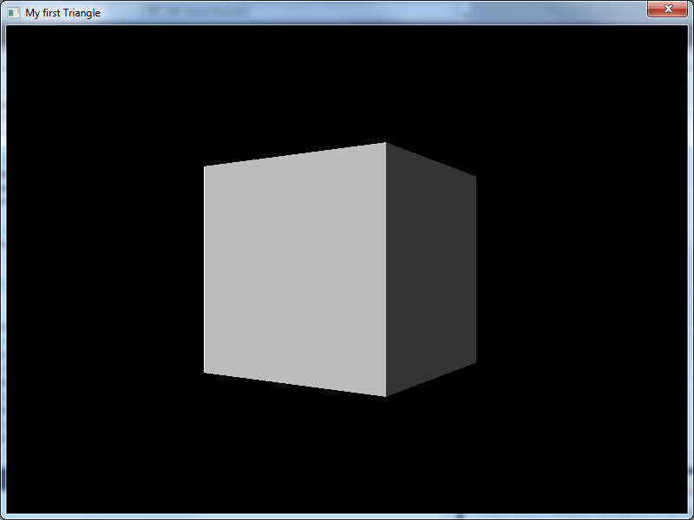

Slide 41
Directional example
Change the colour
GLfloat Light_Diffuse[] = {1.0f, 1.0f, 0.0f, 1.0f};
GLfloat Light_Position[]= {-1.0f, 0.0f, 0.0f, 0.0f};
glLightfv(GL_LIGHT0, GL_DIFFUSE, Light_Diffuse);
glLightfv(GL_LIGHT0, GL_POSITION, Light_Position);
glEnable(GL_LIGHT0);

Slide 42
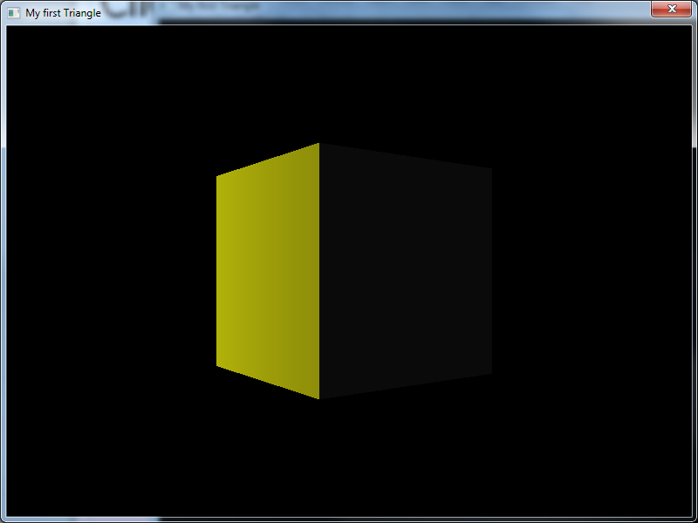

Slide 43
Ambient light
As discussed ambient light is the light that is scattered around the scene and the minimum light value
We setup another variable to control this
GLfloat Light_Ambient[] = {0.4f, 0.4f, 0.4f, 1.0f};
And turn of the diffuse light
GLfloat Light_Diffuse[] = {0.0f, 0.0f, 0.0f, 1.0f};

Slide 44
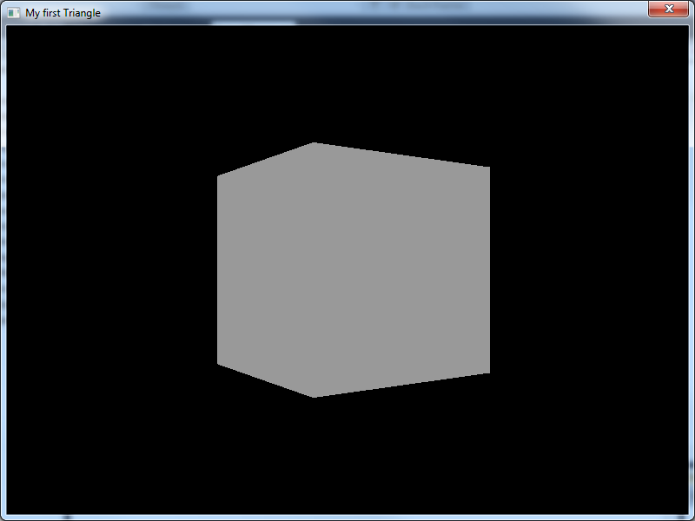

Slide 45
Diffuse and ambient
Turning on the diffuse light (a greater value than ambient)
GLfloat Light_Ambient[] = {0.4f, 0.4f, 0.4f, 1.0f};
GLfloat Light_Diffuse[] = {1.0f, 1.0f, 1.0f, 1.0f};

Slide 46
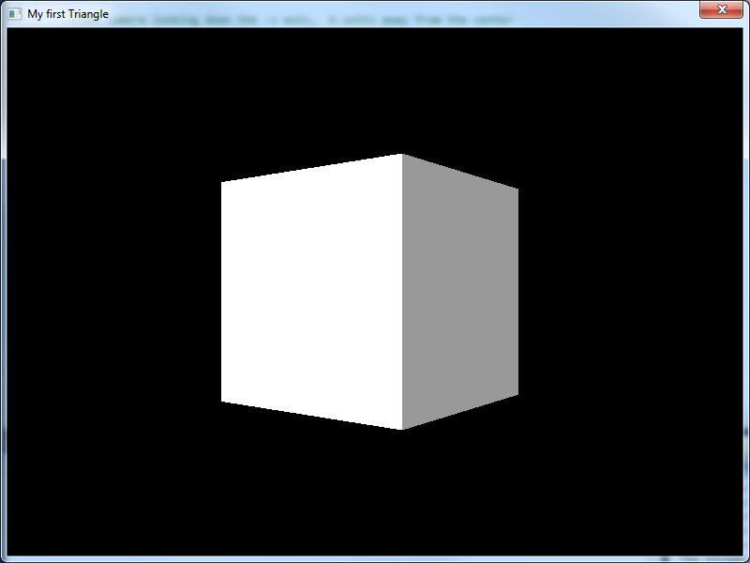
Add diffuse

Slide 47
Different colours
Keeping the ambient light the same
We now change the diffuse light to be magenta
GLfloat Light_Ambient[] = {0.4f, 0.4f, 0.4f, 1.0f};
GLfloat Light_Diffuse[] = {1.0f, 0.0f, 1.0f, 1.0f};

Slide 48
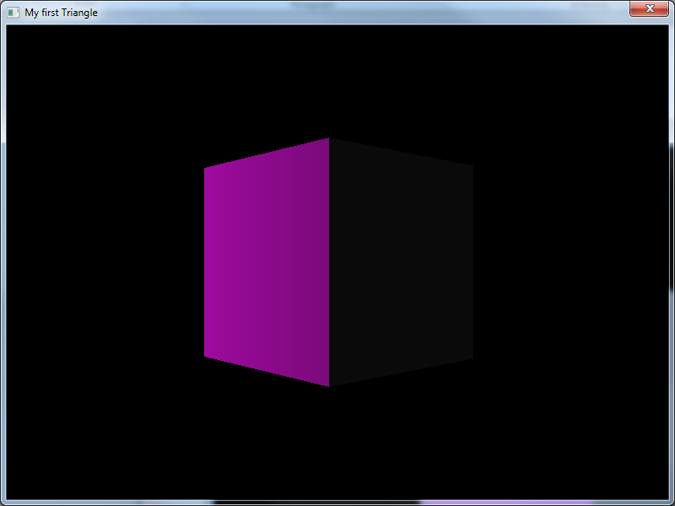
Diffuse colour

Slide 49
Point light
Update the light position variable
Setting the w component to 1.0
Indicating a point light and not a directional light
The x, y, z values are now treated as coordinates
Placing the light in the world
Diffuse is set to white and ambient as before
GLfloat Light_Position[]= {-3.0f, 0.0f, 0.0f, 1.0f};

Slide 50
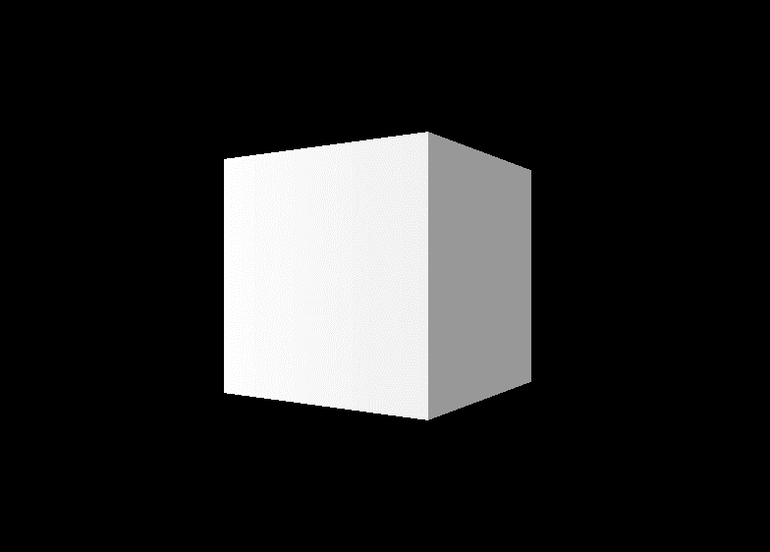
Video

Slide 51
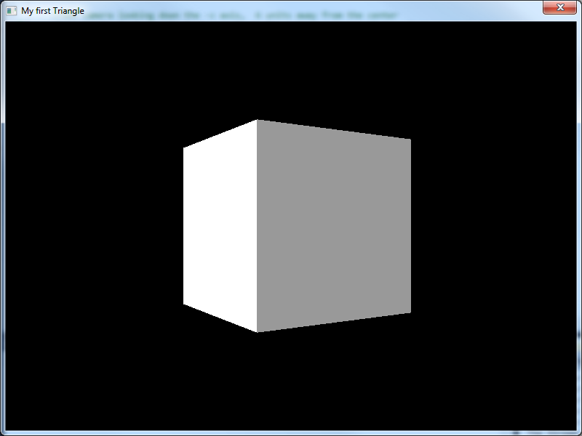

Slide 52
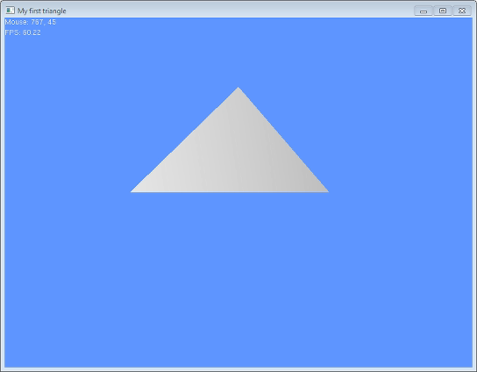
Light at camera position

Slide 53
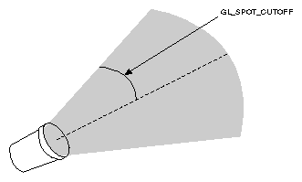
Spot light
In addition to diffuse, ambient and position
A spot light has
Direction
x, y, z vector that describes the lights direction
Cutoff
Between 0 and 90
Describes the angle of the spot light
Exponent
Default zero
Controls how concentrated the light is
Most concentrated at the centre of the cone
Will come into play next week when we discuss attenuation

Slide 54
Spot light
Define our lighting variables
GLfloat Light_Ambient[] = {0.4f, 0.4f, 0.4f, 1.0f};
GLfloat Light_Diffuse[] = {1.0f, 1.0f, 1.0f, 1.0f};
GLfloat Light_Position[]= {0.0f, 7.0f, -5.0f, 1.0f};
GLfloat spot_Direction[]= {0.0f, -1.0f, 0.0f};
Create our light
glLightfv(GL_LIGHT0, GL_AMBIENT, Light_Ambient);
glLightfv(GL_LIGHT0, GL_DIFFUSE, Light_Diffuse);
glLightfv(GL_LIGHT0, GL_POSITION, Light_Position);
glLightf(GL_LIGHT0, GL_SPOT_CUTOFF, 25.0f);
glLightfv(GL_LIGHT0, GL_SPOT_DIRECTION, spot_Direction);
glLightf(GL_LIGHT0, GL_SPOT_EXPONENT, 50.0);
glEnable(GL_LIGHT0);

Slide 55
Spot light
To show this working well you can’t use a simple cube
We need more normals to show the complex light interaction
For this example a detailed plane was generated
A quad made up of 50x50 quads
Scale down so the quads are less than 1 unit
Don’t go to big

Slide 56
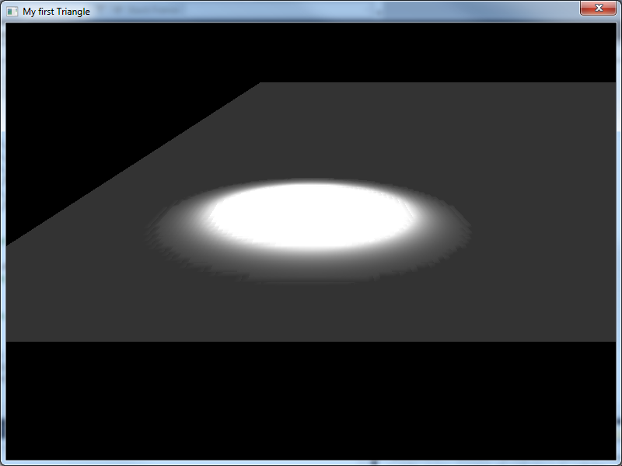

Slide 57
Words of wisdom
Always best to have an object at your light location
So you can see where you light is
Can’t be done with directional light
When you apply transforms to your light it will be easier to track
Easy to hide this object once you know your light is in the correct place

Slide 58
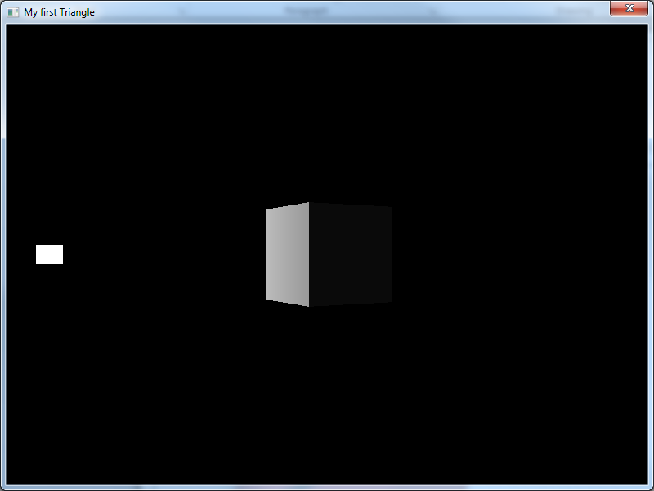

Slide 59
Notes
What the OpenGL lighting system does not replicate:
Reflection / Refraction / caustics
Absorbtion / Scattering / Backwards Scattering
Luminescence
Atmospheric effects : fog / light scattering
And many more
In order to accomplish any additional effects, we have to do them ourselves (3rd Year)

Slide 60
The Blue Universe Conundrum
The problem?
If a universe was made up of only blue objects (same blue) and only blue light, would there be shadows/shading?
Yes? No? What?

Slide 61
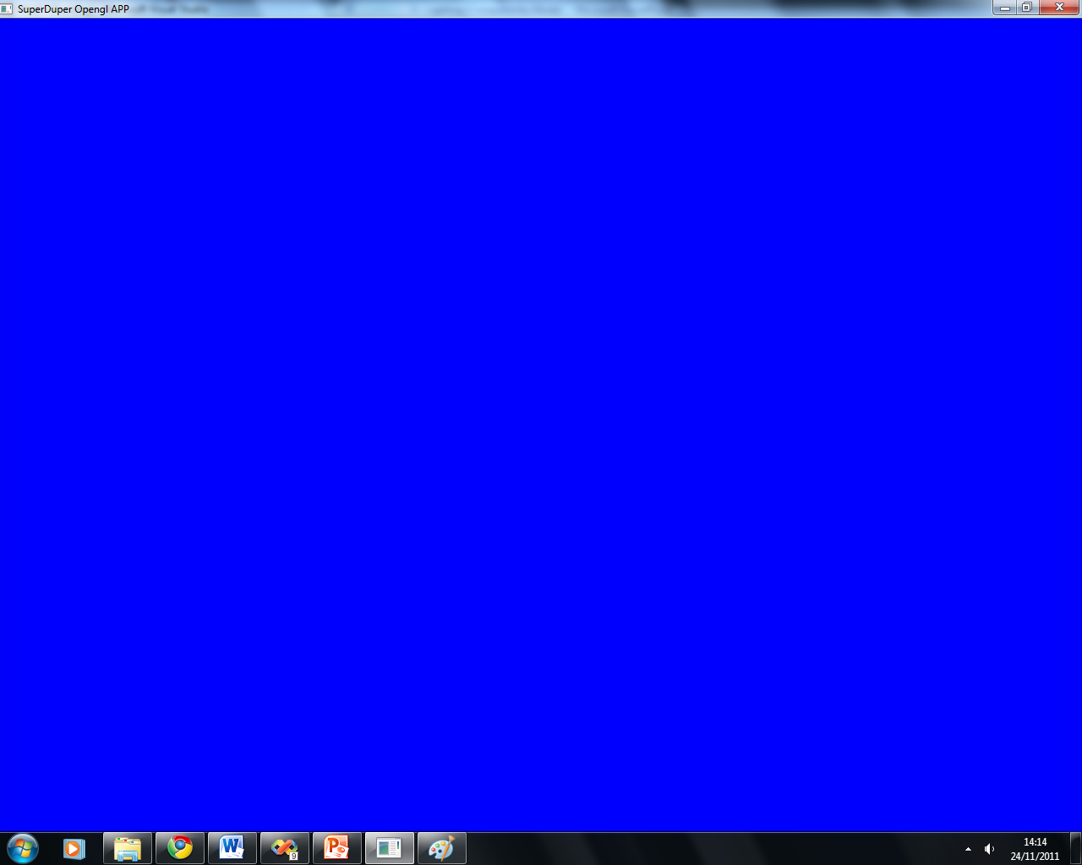
It will be BLUE

Slide 62
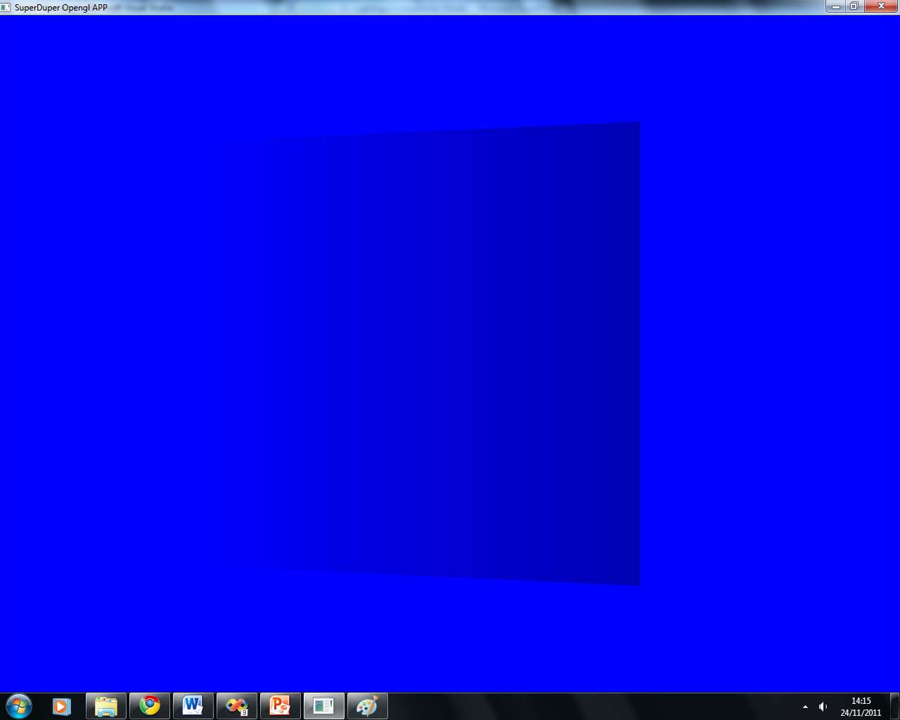
Light settings

Slide 63
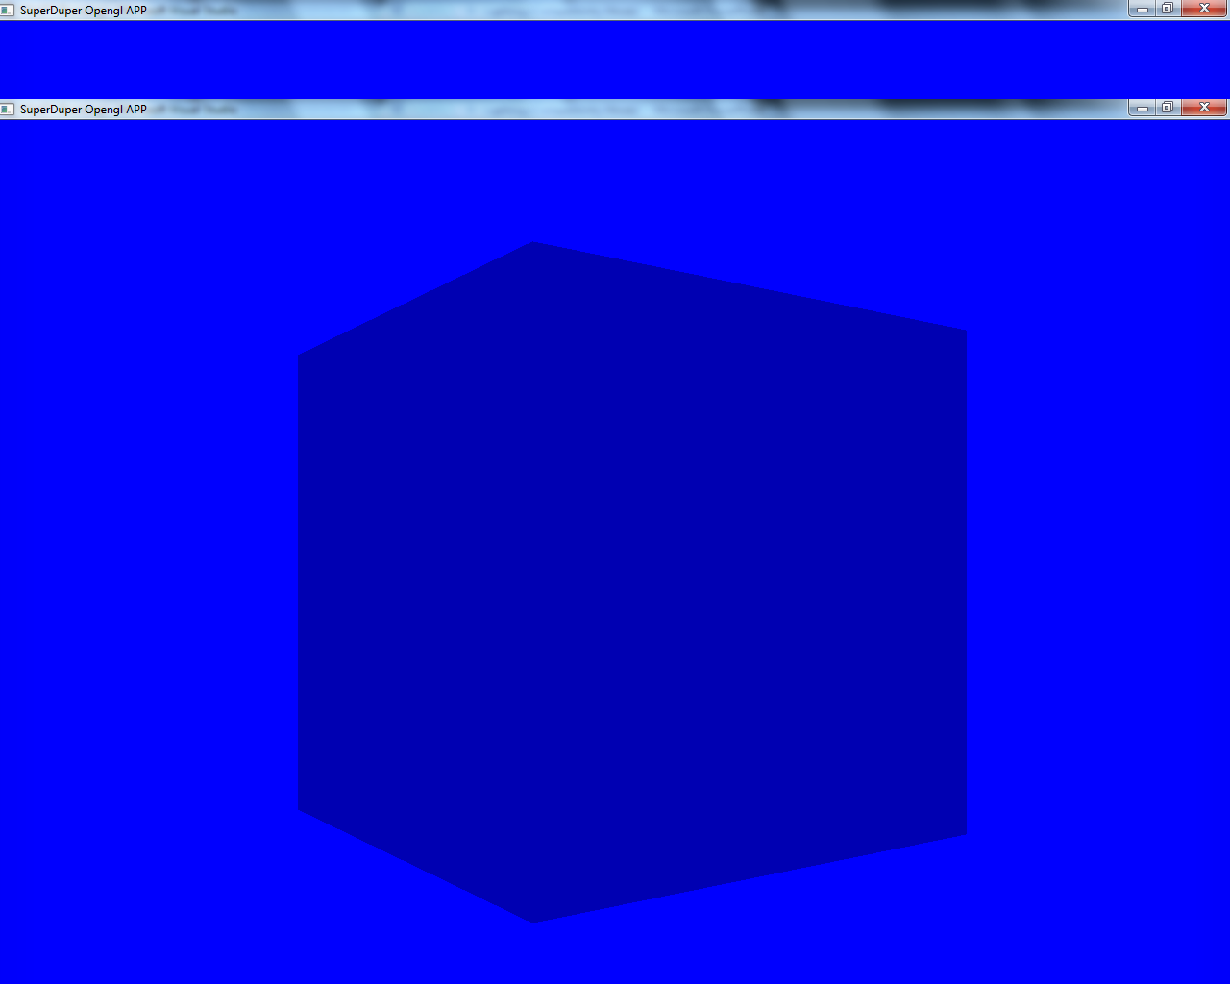
More proof

Slide 64
In the labs
Setting up lights
Directional
Point
Spot
Animating the lights / adding controls

Slide 65
Linear Interpolation
Interpolation
Constructing a new data value using a discrete set of known points
In essence, filling in the gaps given a limited data set
Applications:
Animation
Networking
Shading
Texture Scaling

Slide 66
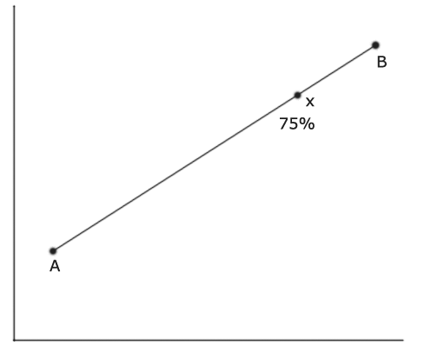
Linear Interpolation
The Theory
Think of it as defining a straight line between the two data values, and then finding a point on that line, a certain proportion along it

Slide 67
Linear Interpolation
Using Linear Interpolation in Code
The formula-> v = (1 - t)v1 + tv2
v is the new data value we want
v1 and v2 are the existing data values we are interpolating between.
t = the proportion between the two points that we wish to sample. t = 0 is the same as v1, t=1 is the same as v2

Slide 68
Linear Interpolation
We can produce a smooth transition between two points by sampling many points in-between
Results may be flawed if there are large distances between samples
If the result is visual (Animation) then the result can be poor
Perfect for certain things
Morphing from one model to another
Reducing the amount of animation data required in games
Blending colour values for lighting

